Slide 1

Time Series Analysis of City Traffic Patterns
Group 7:
Dylaan Cornish
Henry Fernandez
Nicholas Petr
Joey Tomal

Slide 2


Traffic is an issue in almost every major city
Business Problem:
Unpredictable traffic patterns
Inability to detect traffic peaks
Lack of insight on where to invest infrastructure resources
Opportunity Statement: Predict traffic patterns in 4 major city junctions across multi-month forecasts

Slide 3
Data and Model Assumptions
Data Assumptions/Hypotheses:
All vehicle types are collected the same
These major junctions will mimic other major city junctions as well
Four months is a sufficient amount of data/time to model daily traffic
Model Assumptions/Hypotheses:
sMAPE and MASE will be the best model grading criteria
The Forecasting Competition ranking will serve as our model ranking as well

Slide 4
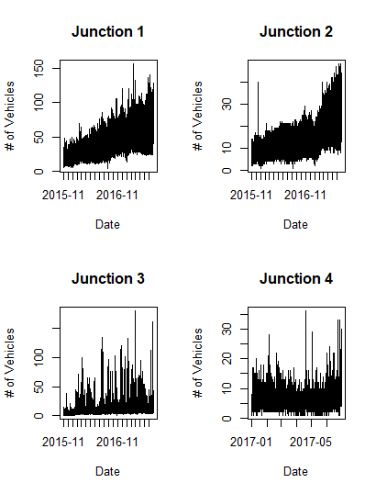
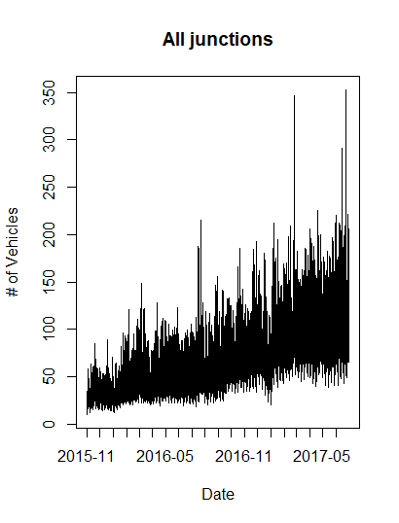
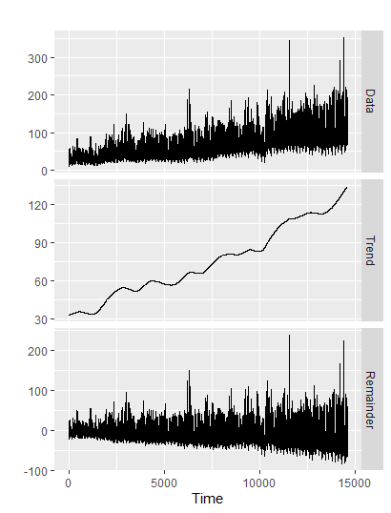
EDA: Each junction shows unique trends and seasonality
Combined Junctions
Notes:
j1-3 all have the same number of observations, but we had to subset to add j4. junction 4 does not have many vehicles

Slide 5
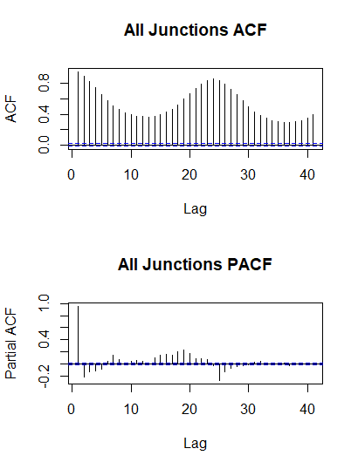
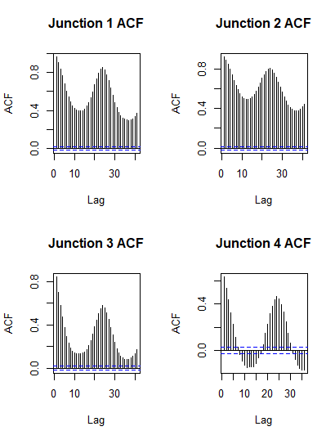
Each junction and the combined junctions show non-stationarity and autocorrelation
Notes:
KPSS and ADF tests also showed non-stationary data. You can see some negative autocorrelation in junction 4, which may be attributed to the slight variation in the dataset

Slide 6
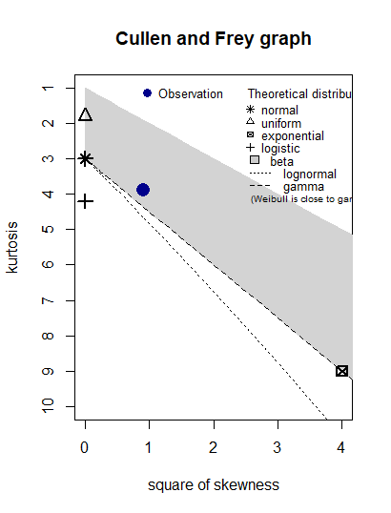
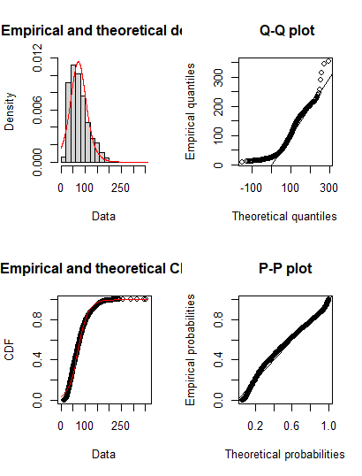
Distribution checks and AIC testing show the combined dataset as a logistic distribution
Notes:
distribution and aic testing was run for normal and logistic distributions, aic values were slightly better for logistic (147983.6) than normal (148153.6)

Slide 7
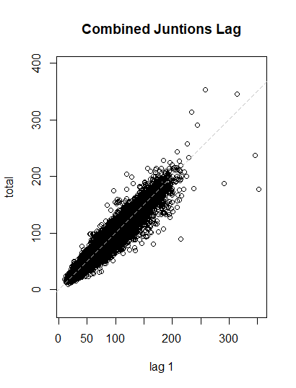
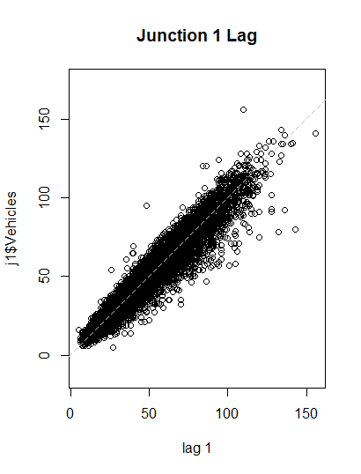
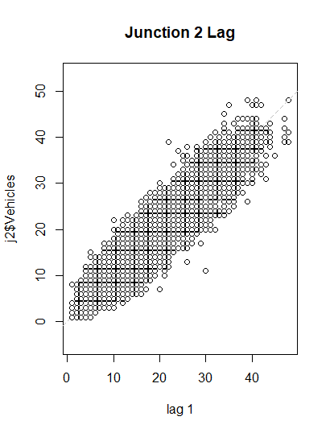
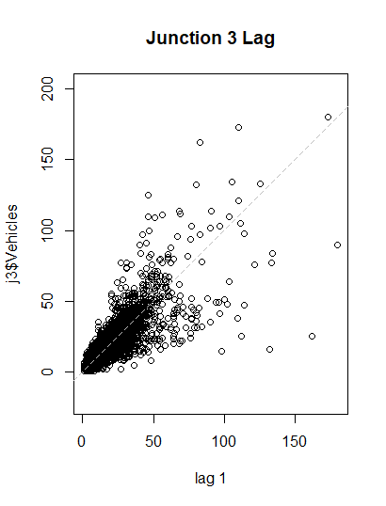
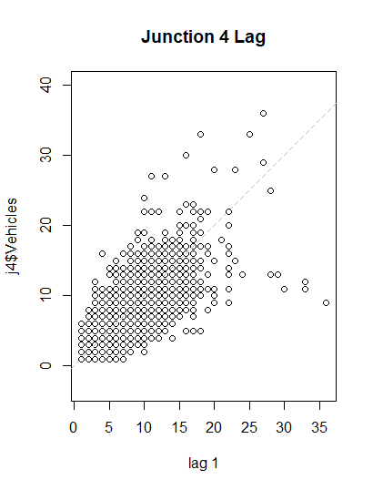
Junctions 1 and 2 show strong positive autocorrelation
Notes:
A lag plot is used to help evaluate whether the values in a dataset or time series are random. If the data are random, the lag plot will exhibit no identifiable pattern. The positive linear pattern suggests positive autocorrelation. The thighness of the dataset clustered around the diagonal for junctions 1 and 2 indicates severe autocorrelation. We can see that junctions 3 and 4 show weaker positive autocorrelation with more outliers. The combined lag plot shows strong positive autocorrelation with outliers
Plots time series against lagged versions of themselves. Helps visualizing ‘auto-dependence’ even when auto-correlations vanish.

Slide 8
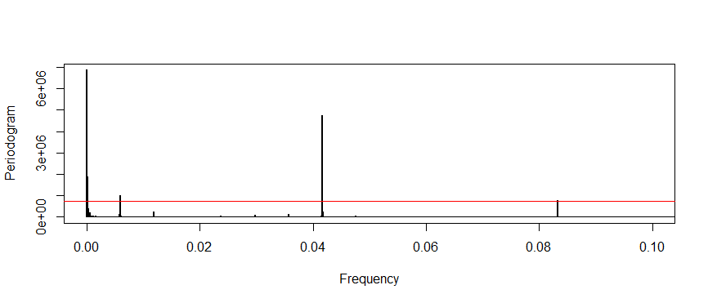
Total Vehicles displays many seasonalities
Seasonalities
15000 | 7500 | 5000 | 168.54 | 24 | 12

Slide 9
Data processing centered around managing the 4 different junctions
Contest data - no data cleaning required
Combine all four junctions into one dataframe
For aggregate and junction dataframes, create test set with last 720 observations

Slide 10
Proposed approaches needed to account for seasonality concerns
TBATS - Multiple, large seasonalities
MSTL - Multiple seasonal decomposition
Seasonal Naive Method - Highly Seasonal
Holt-Winters
Auto Arima
STL

Slide 11
Seasonal Naive outperforms more complex models
 | SMAPE | MASE | Rank
STL | 0.357 | 3.361 | 167
Holt-Winters | 0.172 | 1.646 | 167
Seasonal Naive | 0.098 | 0.997 | 64
ARIMA | 0.352 | 3.343 | 165
TBATS | 0.116 | 1.163 | 65
MSTL | 0.108 | 1.024 | 101

Slide 12
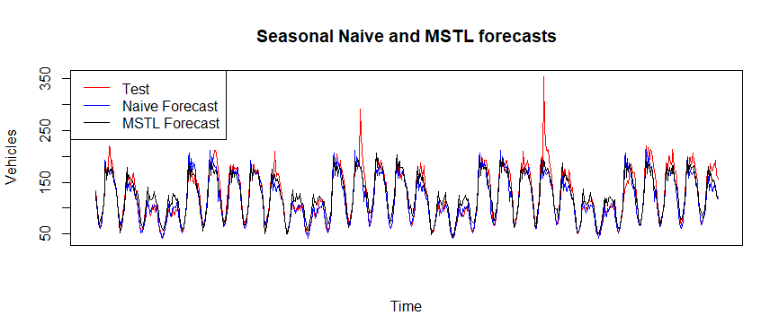
Top two models show similar one month forecasts

Slide 13
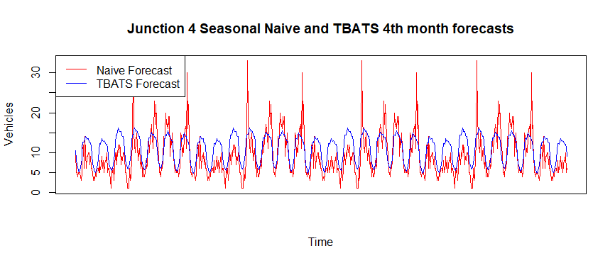
Four month TBATS forecast is more stable than Seasonal Naive

Slide 14
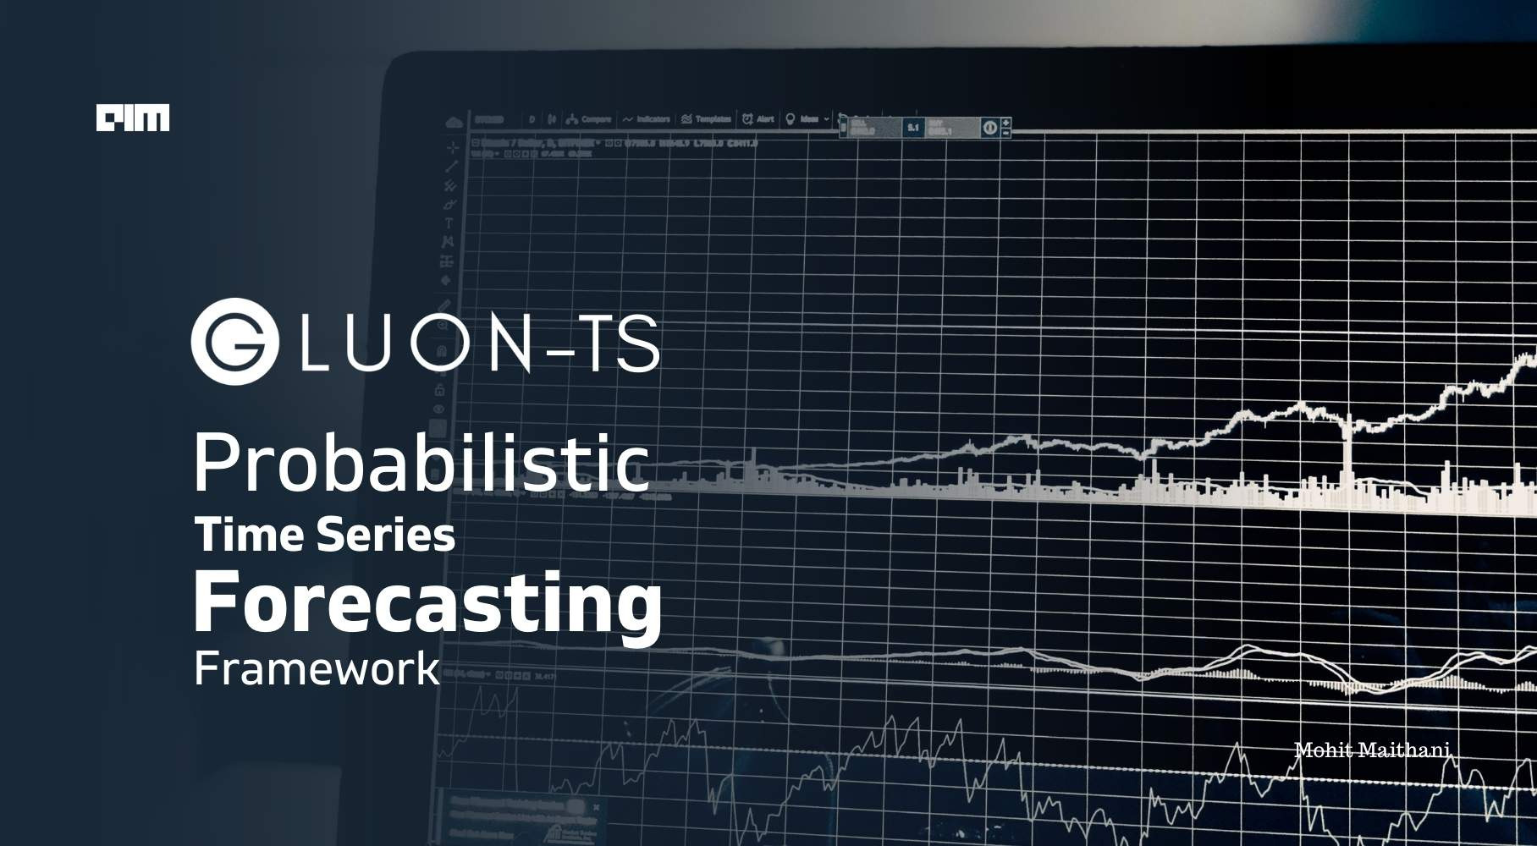
Future work will increase forecasting complexity and accuracy
Compare results with deep learning
Model junction four as an intervention
Include Holidays package to more effectively model traffic spikes

Slide 15
Github and References
https://github.com/dylaancornish/traffic_forecasting
De Livera, Alysha & Hyndman, Rob & Snyder, Ralph. (2010). Forecasting Time Series With Complex Seasonal Patterns Using Exponential Smoothing. Journal of the American Statistical Association. 106. 1513-1527. 10.1198/jasa.2011.tm09771.
Makridakis S, Spiliotis E, Assimakopoulos V (2018) Statistical and Machine Learning forecasting methods: Concerns and ways forward. PLOS ONE 13(3): e0194889. https://doi.org/10.1371/journal.pone.0194889
Dataset:
https://www.kaggle.com/datasets/vetrirah/ml-iot
Competition URL:
https://datahack.analyticsvidhya.com/contest/janatahack-machine-learning-for-iot/True/#SolutionChecker

